Slide 1
Terminology & Scope of Deployment
Lecture 2

Slide 2
Terminology used throughout the course
AWS specific service terms
  IAM = Identity & Access Management
  S3 = Simple Storage Service
  EC2 = Elastic Compute Cloud
IAM Policies = A definition of permissions for AWS services for a principal. Written & stored in JSON (JavaScript Object Notation)
PKI = Public Key Infrastructure (Roles, Policies, Hardware to create and maintain digital certificates to match identity)

Slide 3
Terminology used throughout the course
HashiCorp Vault specific terms
  Secrets Engine = Uses IAM policies to dynamically perform IAM AWS API calls to add access keys & secret access keys for users
  Secret = Term used by Vault for confidential data
  Lease = The duration that a token is granted
  Token = A dynamic mapping to information
View the ‘Vault Concepts and further training’ in the additional curriculum section of the lecture for more information

Slide 4
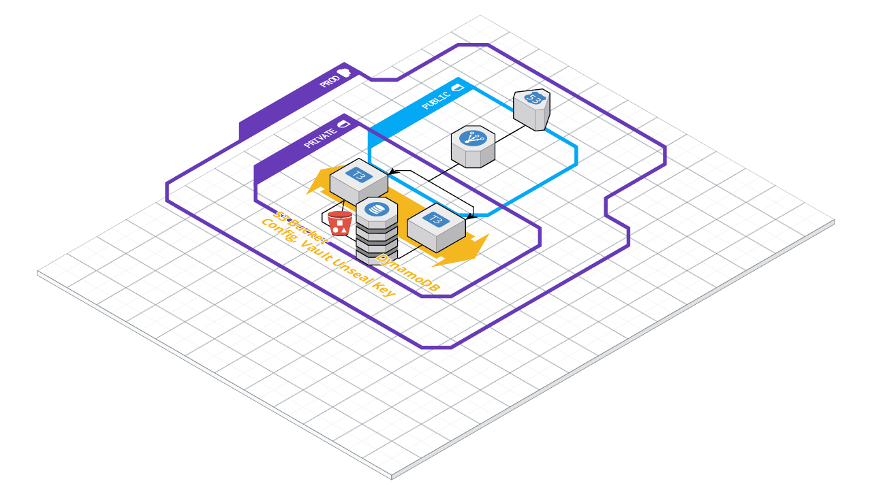
Scope of Deployment (Infrastructure)
1 VPC
2 Subnets (Public, Private)
2 Availability Zones
1-2 T3.Micro EC2 Vault Servers
Launch Configuration & Auto Scaling Group based on CPU usage
S3 Bucket for encrypted configuration & unseal key storage
DynamoDB + Global Table (if desired) for database backend
Application Load Balancer to distribute traffic
Route53 to handle public DNS forward hosted zone and record set

Slide 5
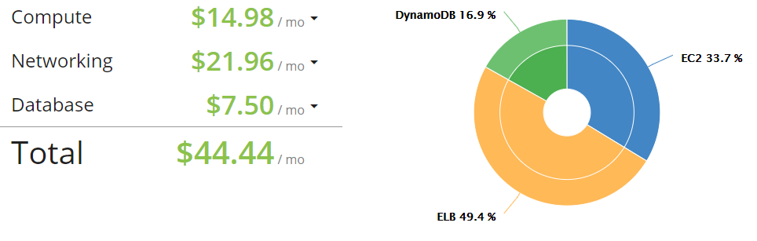
Scope of Deployment (Costs)
Based on on-demand EC2 pricing for T3.Micro
Cost savings with EC2 spot instances when set in the launch configuration
DynamoDB using on demand resources

Slide 6
Next Lecture
Set up the environment in AWS
Deploy

