Slide 1

Set up the environment (AWS)
Lecture 3

Slide 2
Set up the environment (AWS)
Prerequisites
  AWS Account, or sub-account in good standing
  IAM access to create new IAM users, groups and roles
  Unrestricted EC2 access to create EC2 instances, launch configurations, load balancers and auto scaling groups
  Access to create a new DynamoDB table and configuration ability
  Access to create new S3 buckets
  Access to create a new record set in a Route53 forward zone
  CloudFormation stack creation abilities
  A VPC with a public and private zone (see Cloudformation: VPC in 2AZ in additional resources)

Slide 3
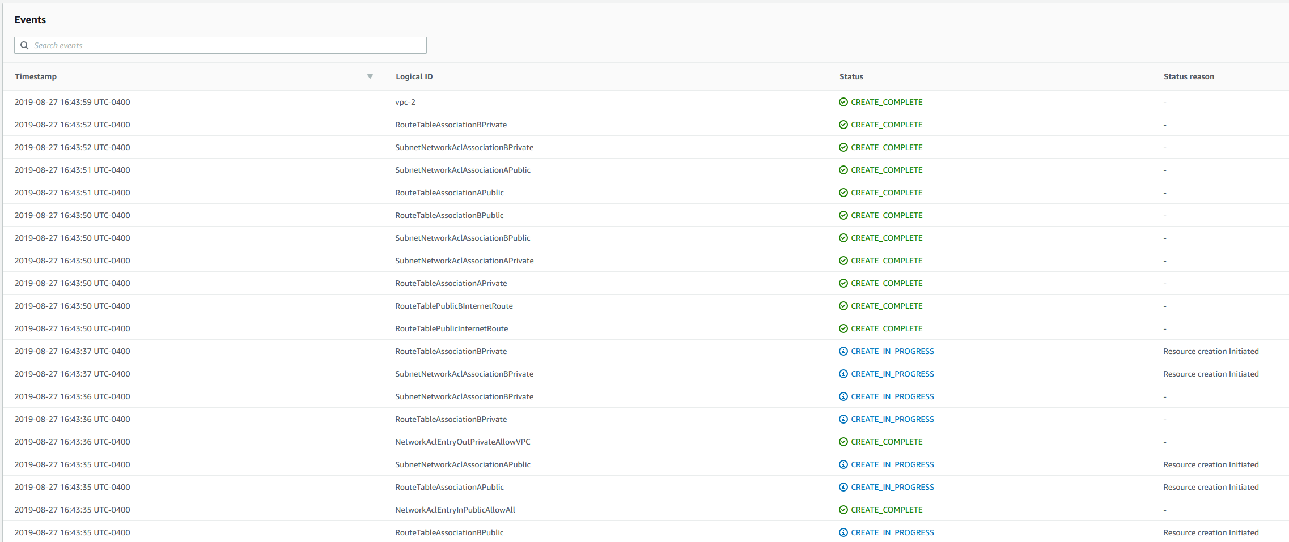
Step-by-Step: VPC
  Use the Cloudformation: VPC in 2AZ external resource to deploy using AWS CloudFormation
  Set the ClassB key value to whichever you prefer. In our example, it’s set to 10.
  You will see the VPC stack deploy with two availability zones.
  Take note of the VPC-id, it will be used throughout.

Slide 4

Step-by-Step: VPC
  Now we will wait while the VPC CloudFormation stack is deployed. Feel free to skip past this part if you’ve created your VPC already.

Slide 5
Step-by-Step: Route53
  Create your Route53 forward DNS zone if not already completed
  Set your domain provider’s nameservers to AWS nameservers
  Wait (up to 24hours) to propagate
  Once globally resolving, follow the next steps

Slide 6
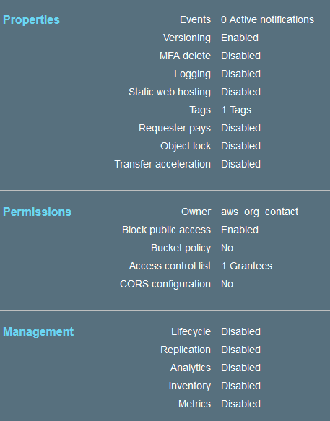
Step-by-Step: S3
  Browse to S3>Create Bucket
  Name it hcvault-config and append a unique identifier to the end. All S3 buckets must have a unique name
  Follow the steps to create a private bucket
  Settings should be similar to what is pictured on the right

Slide 7
Step-by-Step: Amazon Certificate Manager (ACM)
  Ensure you have your Route53 forward zone created
  Generate a certificate request (public) for vault.yourforwardzone.tld or use a wildcard such as *.yourforwardzone.tld
  Add the DNS CNAME verification option to automatically verify using Route53

Slide 8
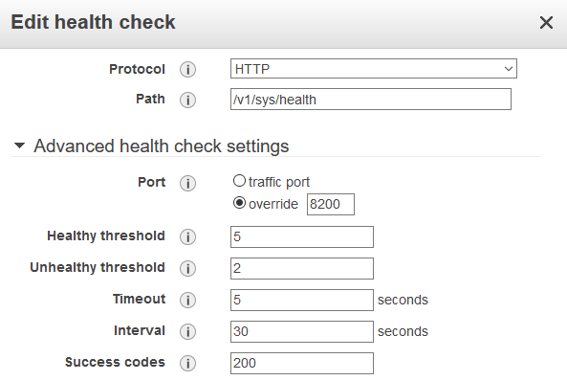
Step-by-Step: EC2 Application Load Balancer
  Create a new Application Load Balancer spanning your two public availability zones in your new VPC created previously
  Select Internet Facing, two HTTPS listeners over tcp/443 & tcp/8200
  Bind the certificate you generated from ACM in the previous step to the listeners
  Create a new security group that allows tcp/443 from 0.0.0.0/0 ingress named vault-sg-elb
  Create a new target group, HTTP protocol over port tcp/8200
  Set the health check to what is pictured on the right

Slide 9
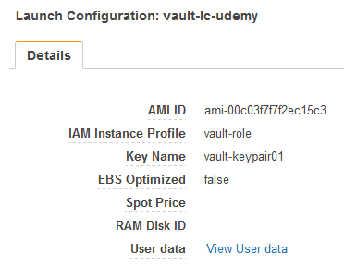
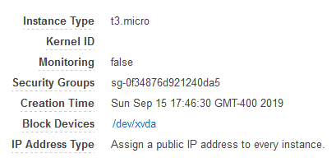
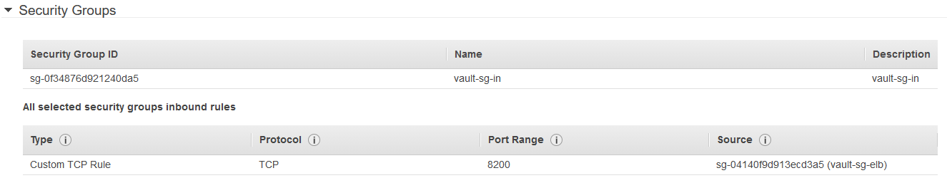
Step-by-Step: EC2 Launch Configuration
  Browse to EC2>Auto Scaling>Launch Configurations>Create launch configuration
  Retrieve aws_ec2_user_data.txt from external resources in the lecture. Use this for the UserData section.
  Create a new KeyPair, store is safely
  Use T3.Micro for instance type, Amazon Machine Linux 2 (ami-00c03f7f7f2ec15c3)
  Select Spot Instance if desired, set prices accordingly
  Select ‘Assign a public IP address to every instance.’
  Select the IAM role we created previously (vault-role)
  Select the security group that will allow only tcp/8200 traffic from the elastic load balancer (vault-sg-elb)
  It should resemble what is pictured to the right

Slide 10
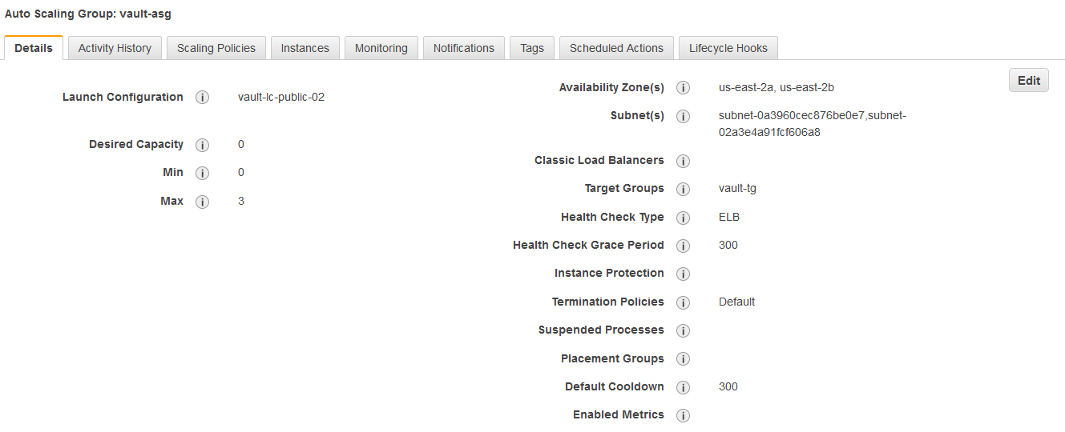
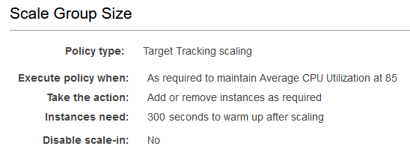
Step-by-Step: EC2 Auto Scaling Group
  Browse to EC2>Auto Scaling>Auto Scaling Groups>Create Auto Scaling Group
  Name it vc-asg or similar
  Set the target tracking for auto scaling to what is pictured on the right
  Set the desired capacity to 2, min 1, max 3
  Set health check to ELB
  Set the target group accordingly
  Set the subnets to the private subnets previously created

Slide 11
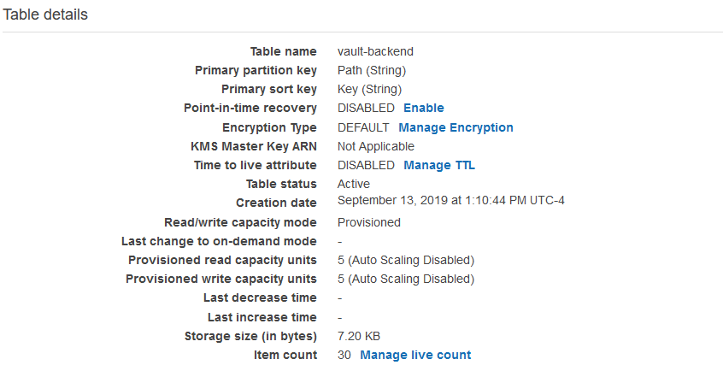
Step-by-Step: DynamoDB
  Browse to DynamoDB>Create Table
  Name the table name similar to what is pictured
  Set Primary Partition Key to PATH
  Set Primary Sort Key to KEY
  Create the DynamoDB table

Slide 12
Step-by-Step: IAM
  Create an IAM role named vault-role
  Attach policies to allow for DynamoDB full access (restrict ARN to the DynamoDB table you created earlier)
  Full access to S3 (restrict ARN to the S3 bucket you created earlier)
  Full access to IAM (for AWS secrets engine access key generation)

Slide 13
Final Steps
  We’ll take another break to allow for any resource creation (for example, DynamoDB)

Slide 14
Next Lecture
Set up HashiCorp Vault in AWS
Deploy

