Slide 1

Set up HashiCorp Vault on AWS
Lecture 4

Slide 2
Set up HashiCorp Vault on AWS (S3 dependancies)
  Retrieve vault-config.txt from External Resources in the lecture and rename it to vault-config.hcl
  Edit it to replace the region & table values
  Retrieve vault-unseal.txt from External Resources in the lecture and rename it to vault-unseal.sh
  Upload vault-config.hcl , vault-unseal.sh to your S3 bucket created in lecture 3

Slide 3
Set up HashiCorp Vault on AWS (Vault Unseal)
  Create a Route53 record set, using an alias to point to the elastic load balancer created in lecture 3
  Wait until the record set propagates
  Browse to the record set (for example, https://vault.example.com)
  You will be forwarded to the ELB, in which will be prompted to set up and initialize Vault

Slide 4
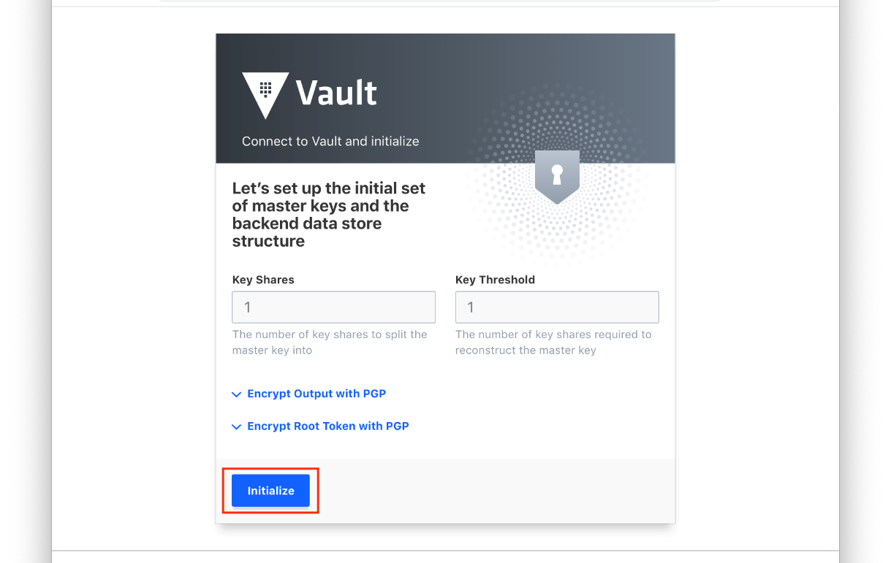
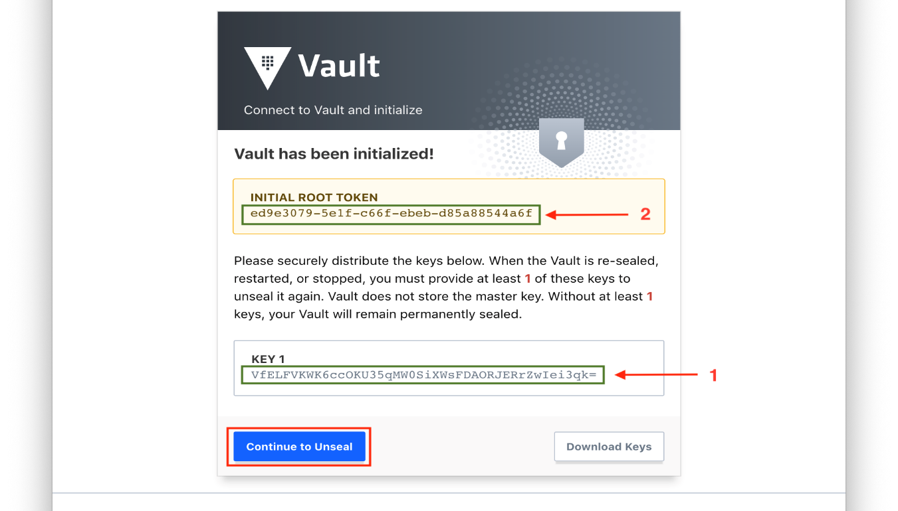
Set up HashiCorp Vault on AWS (Vault Init)

Slide 5
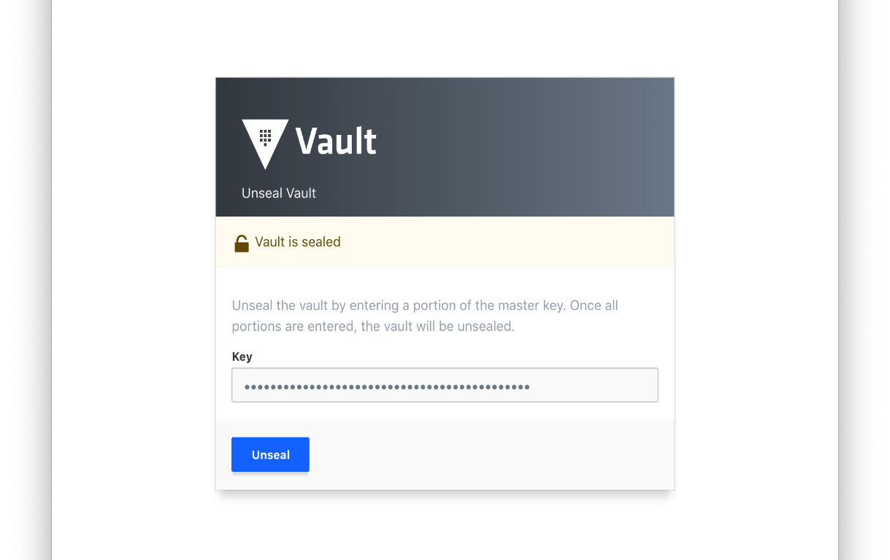
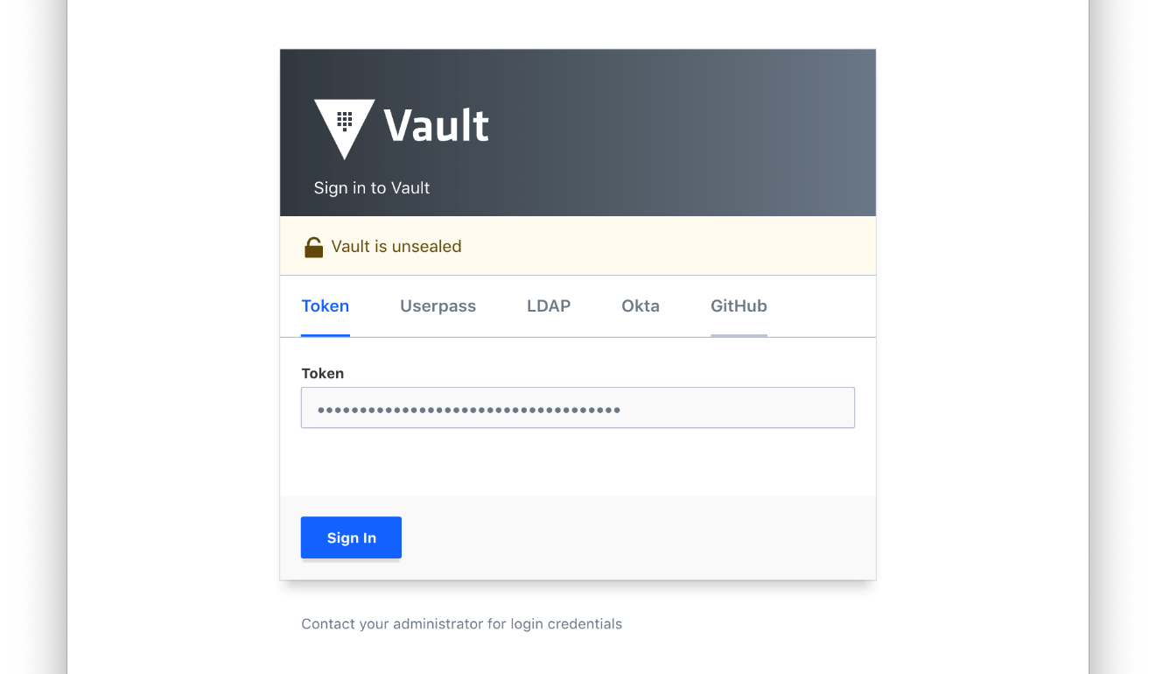
Set up HashiCorp Vault on AWS (Vault Init)

Slide 6
Set up HashiCorp Vault on AWS (S3 retrieval)
  Create a file named payload.json and paste in the KEY 1 value you initialized the vault with.
  Contents of payload.json:
  {
  "key": “yourpastedkeyvalue“
  }
  Upload payload.json to the S3 bucket created in lecture 3
  Now, the user-date init script defined in the EC2 launch configuration will automatically unseal the vault and mark it as healthy (200 Status for the ELB)

Slide 7
Set up HashiCorp Vault on AWS (S3 unsealing)
Auto scaling group increases desired capacity
Launches launch configuration
User data uses vault-unseal.sh to retrieve payload.json
Vault automatically unseals and marks HTTP Header 200 for ELB
Users can login to Vault

Slide 8
Next Lecture
AWS Secrets Engine Configuration

