Slide 1
Deploying HashiCorp Vault with AWS Secrets Engine
Troy dieter
Solutions architect
2019

Slide 2
Requirements for the course
Working knowledge of AWS with access to deploy to AWS EC2, IAM, DynamoDB & Route53
Intermediate understanding of AWS IAM Roles & Policies
General understanding of encryption & PKI

Slide 3
Implementation
Easy to use IAM access keys and secret access keys for your organization
Scalable, Highly Available Vault deployment
Security of ephemeral (limited use) access keys and secret access keys
Further limit organization for granular permissions
Ability to quickly revoke all deployed access keys, secret access keys

Slide 4
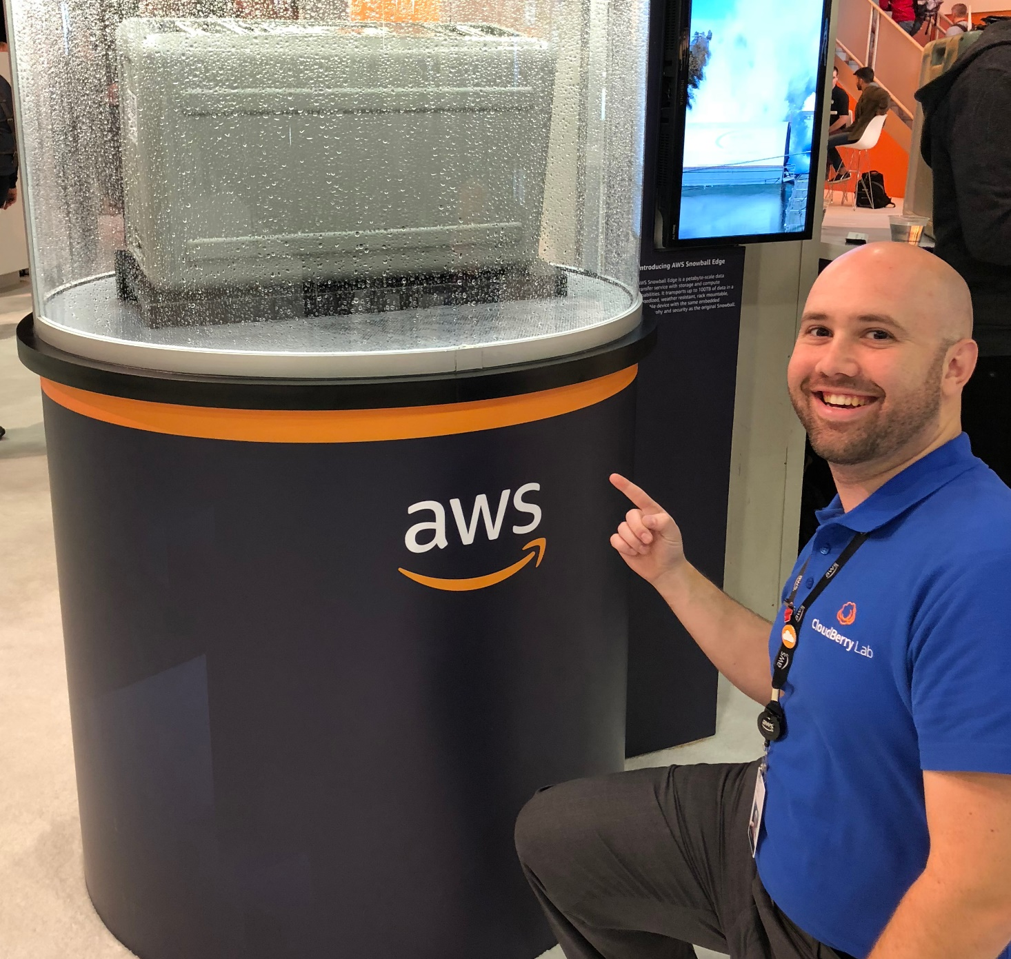

About me
Troy Dieter
AWS Certified Solutions Architect
Passionate about development & security tools to make our lives easier
Short time Kubernetes user, long time Docker user
Long time Linux user, first distribution used was Mandrake Linux back in the mid-90’s

Slide 5
Next Lecture
Terminology
Scope of deployment

