Slide 1

AWS Secrets Engine Configuration
Lecture 5

Slide 2
AWS Secrets Engine Configuration
  Browse to your https://vault.example.com address
  Login using the root token that was granted on initialization
  Follow the steps on the next few pages for creating access keys and secret access keys for a Data Scientist, who will have the IAM policy ‘DataScientist’ attached.

Slide 3
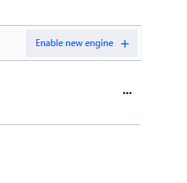
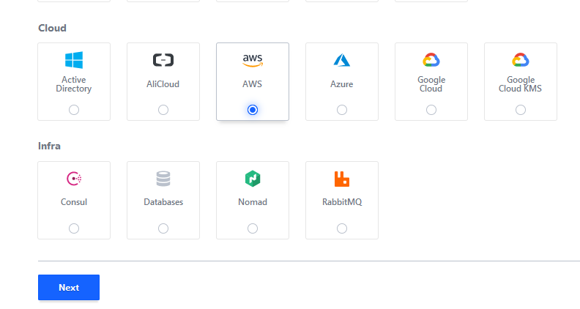
AWS Secrets Engine Configuration
  Select ‘Enable new engine’
  Select AWS

Slide 4
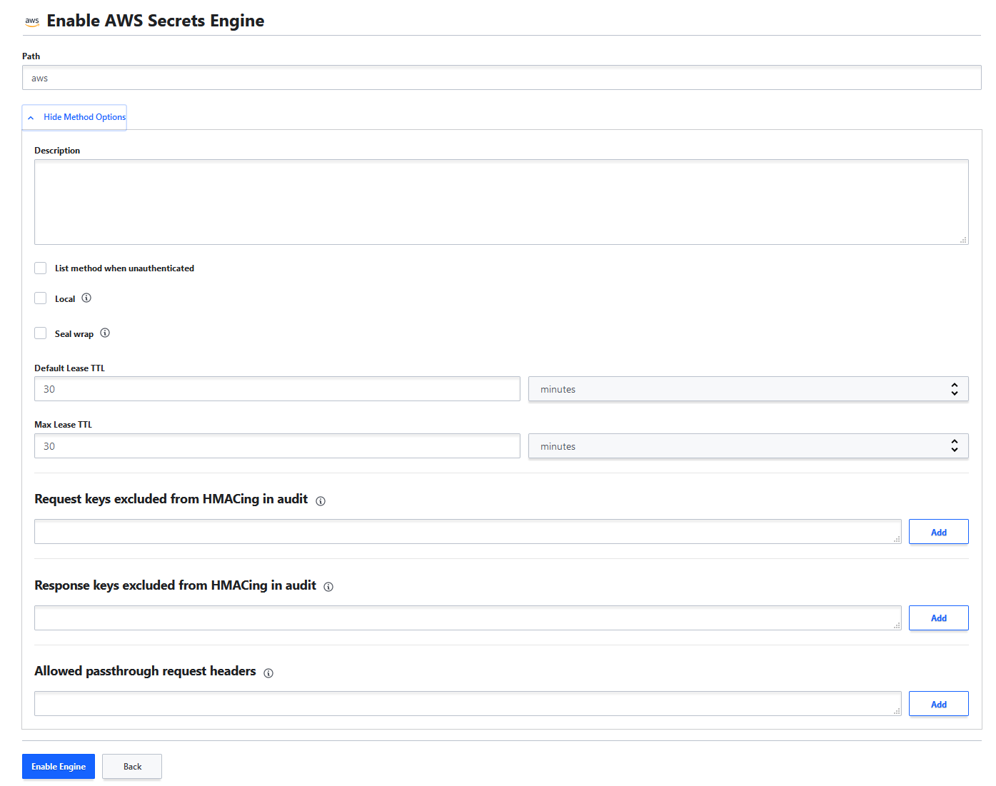
AWS Secrets Engine Configuration
  Leave the path ‘aws’
  Add a description if desired
  Set ‘default lease TTL’ to how long the granted token lease will be
  Max Lease TTL defines the ceiling for token lease time. Tokens can be renewed, which counts against this value
  Select ‘Enable Engine’

Slide 5
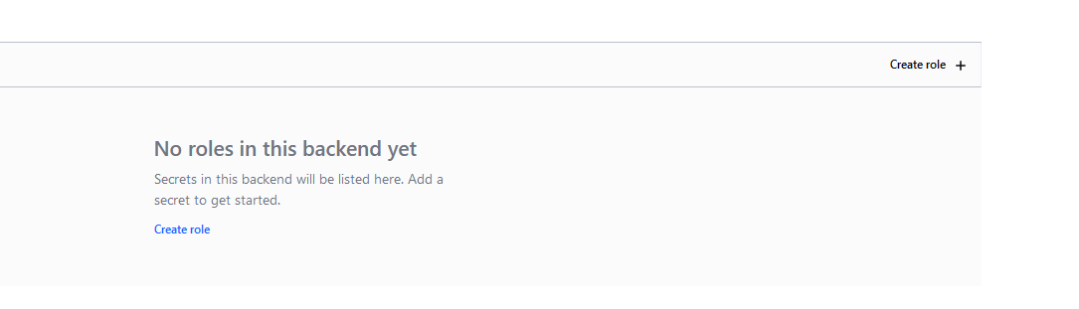
AWS Secrets Engine Configuration
  Select ‘Create Role’

Slide 6
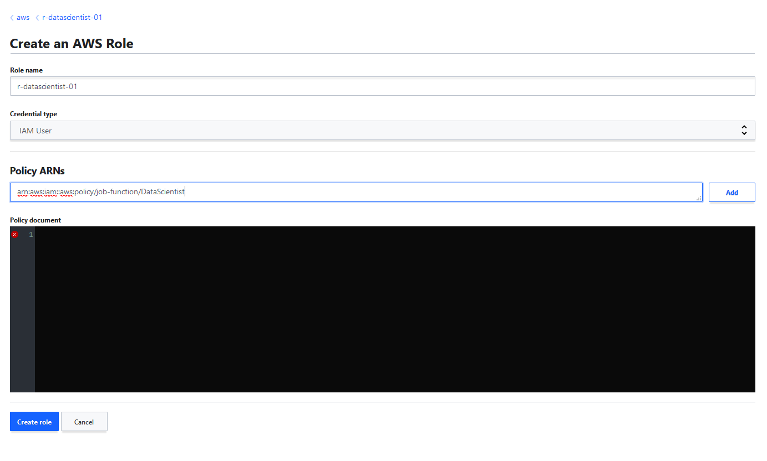
AWS Secrets Engine Configuration
  Define a role name. The path ‘aws’ is always prefixed. This role path would be: ‘/aws/r-datascientist-01/creds/’
  Select ‘IAM User’
  Add a valid AWS IAM Policy ARN value that will allow for permissions to be granted for the access key, secret access key

Slide 7
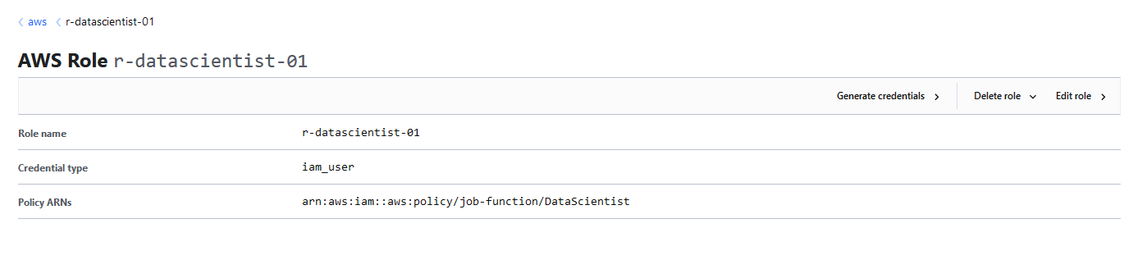
AWS Secrets Engine Configuration
  The new AWS secrets engine role has been created.

Slide 8
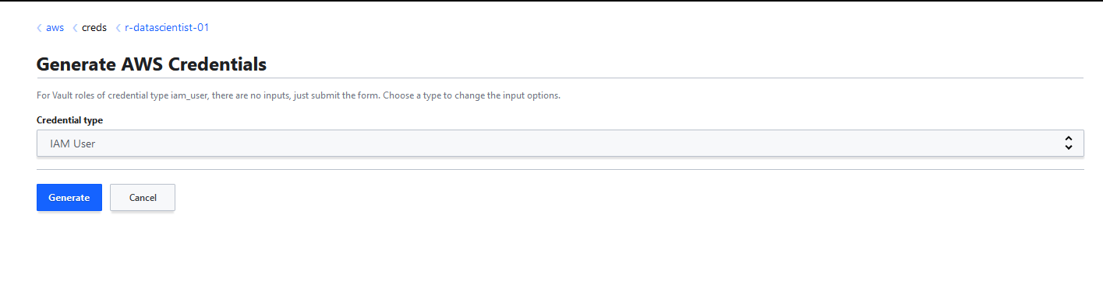
AWS Secrets Engine Configuration
  Attempt to create credentials for this role. Select IAM User and Generate

Slide 9
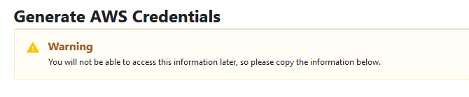
AWS Secrets Engine Configuration
  A valid AWS Access Key & Secret Access Key will be generated, with the Policy ARN you specified in the role creation attached.
  Congratulations, you just created your first ephemeral access key & secret access key!

Slide 10
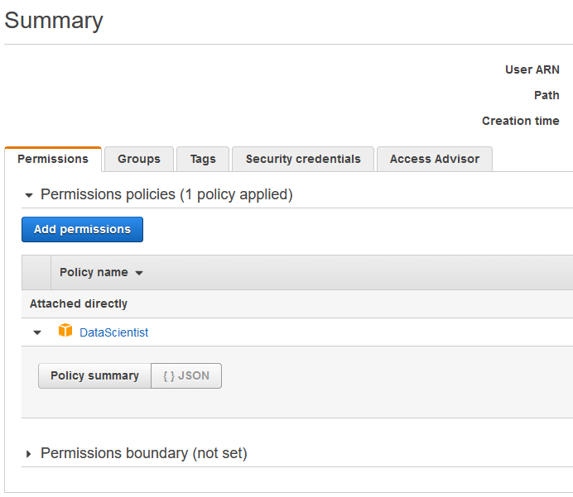
AWS Secrets Engine Configuration
  Behind the scenes in your AWS account, you can see a new IAM user created with a long string name value. It will have the policy ARN attached that you set in the AWS secrets engine role creation.
  These access keys and secret access keys are valid for 30 minutes. They will then be revoked by Vault and unusable!

Slide 11
Next Lecture
Adding additional authentication methods to extend Vault

